Slide 1
Toronto vs Vancouver Restaurants

Slide 2
Introduction: Using Yelp and GeoApify to Analyze Restaurants
This project uses the Yelp Fusion API and Geoapify API to compare restaurants in Toronto and Vancouver.
Using business data from the Yelp API combined with distance data from GeoApify, analysis were made from restaurant ratings, proximity to busier areas, restaurant preferences, types of restaurant, and hours of operation. Due to API limitations, the Yelp API can only provide a sample population of a thousand restaurants for each city, for which the analysis were based on.

Slide 3
Toronto Vs. Vancouver: Who has Better Restaurants?
Hypothesis: Toronto has better rated restaurants

Slide 4
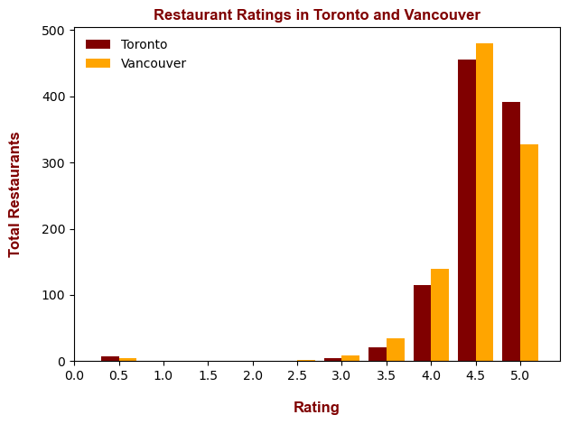
Histogram: Toronto vs. Vancouver Restaurant Ratings
Histogram: This highlights the total number of restaurants that fall into specific ratings in each city
Yelp API only gives 1/2 star reviews without any in-between averages (i.e. restaurants are only 4.5 or 5 star, no “4.8 star” ratings)
Toronto NormaltestResult(statistic=710.5969813838792, pvalue=4.96393474763195e-155)
Vancouver NormaltestResult(statistic=589.8227297653107, pvalue=8.348752392074616e-129)
In general, the majority of restaurants in each city is 4 stars and above. From the data shown, Toronto has a larger number of 5 star rated restaurants compared to Vancouver, with Vancouver showing more 4.5 and 4 star restaurants compared to Toronto.
Even without normalization tests, it's pretty obvious that the data is not normally distributed, as most restaurants are heavily skewed above 4 stars

Slide 5
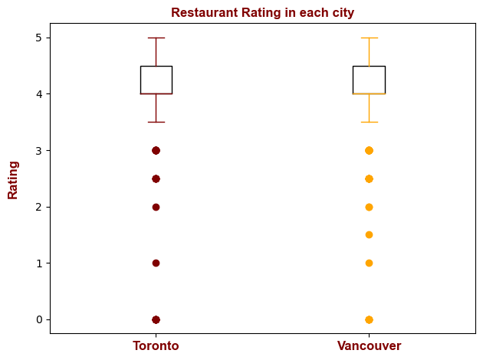
Box and Whisker: Toronto vs. Vancouver Ratings
Box and Whisker Plot: Same comparison as the histogram, but with more statistical analysis!
For the city of Toronto
The lower quartile is: 4.0
The upper quartile is: 4.5
The interquartile range is: 0.5
The median is: 4.0
Values below 3.25 could be outliers.
Values above 5.25 could be outliers, which is not possible.
For the city of Vancouver
The lower quartile is: 4.0
The upper quartile is: 4.5
The interquartile range is: 0.5
The median is: 4.0
Values below 3.25 could be outliers.
Values above 5.25 could be outliers, which is not possible.
On first glance, the histogram data seems to imply a greater share of restaurants in Toronto are 5 stars compared to in Vancouver. However when plotted as a box and whisker diagram, there is very little statistical difference in restaurant ratings between the two cities. Both cities have interquartiles between 4-4.5 stars, with the median sitting at 4 stars. Using 1.5IQR test, anything below 3.5 stars is considered an outlier.

Slide 6
Analysis
It is currently unknown how Yelp chooses which restaurants to return for the search queries. The data does not appear to be random sampling as multiple searches of the database seems to return the exact same results. There could be implicit bias in the sample population as Yelp could return queries that feature highly rated or popular restaurants. Or, maybe restaurants in both cities are actually just high quality.
Hypothesis Answer:
There may be implicit bias in the population sample. Based on the data that was collected however, there does not appear to be a large difference in restaurant ratings between Vancouver and Toronto.

Slide 7
Does Driving Distance Affect Restaurant Ratings?
Hypothesis: The farther a restaurant is from city landmarks, the more likely it will have lower review scores

Slide 8
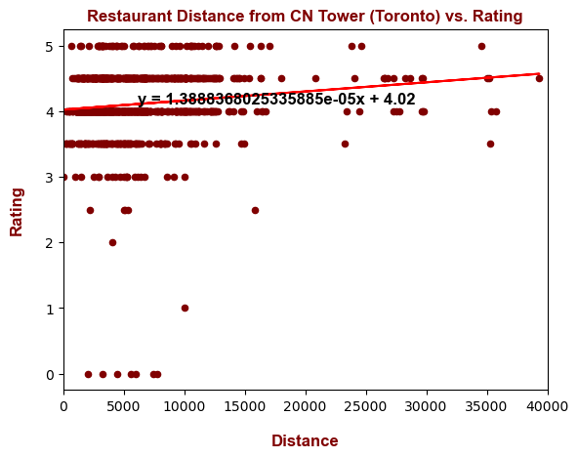
Scatterplot: Toronto Restaurant Rating vs. Distance
This highlights the driving distance from a local landmark in each city to each restaurant from the Yelp API data pull. For Toronto, the landmark is the CN tower.
The r-squared is: 0.016820481368420633
PearsonRResult(statistic=0.12969379849638393, pvalue=3.966754766151683e-05)
The r-squared value and the Pearson Test both show very little correlation between restaurant distance vs restaurant rating

Slide 9
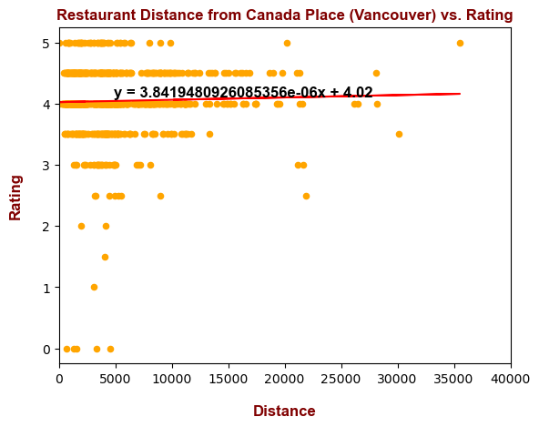
Scatterplot: Vancouver Restaurant Rating vs. Distance
This highlights the driving distance from a local landmark in each city to each restaurant from the Yelp API data pull. For Vancouver, the landmark is Canada place.
The r-squared is: 0.000881199587707198
PearsonRResult(statistic=0.02968500610926668, pvalue=0.34837038519649094)
The r-squared value and the Pearson Test both show very little correlation between restaurant distance vs restaurant rating

Slide 10
Analysis
Both R-squared values and Pearson correlation shows that there is very weak/non-existent correlation between restaurant distance and rating
This implies that either restaurant quality throughout each city is good, or that the sampling from Yelp is biased towards suggesting highly rated restaurants with no regard to distances
Hypothesis Answer:
There may be implicit bias in the population sample- if there is, Yelp does not bias based on restaurant distance from landmarks.. Based on the data that was collected however, there does not appear to be a correlation between restaurant ratings vs. distance from landmarks.

Slide 11
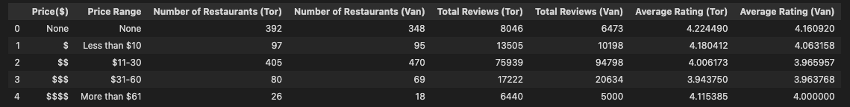
What type of restaurants do Toronto and Vancouver prefer?
$ = less than 10 dollars
$$ = 11 - 30 dollars
$$$ = 31 - 60 dollars
$$$$ = more than 61 dollars

Slide 12
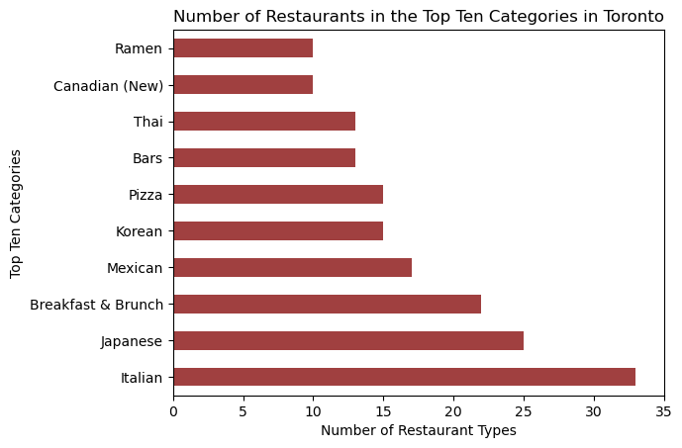
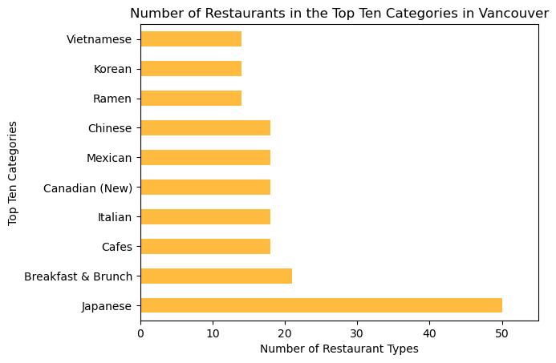

Slide 13
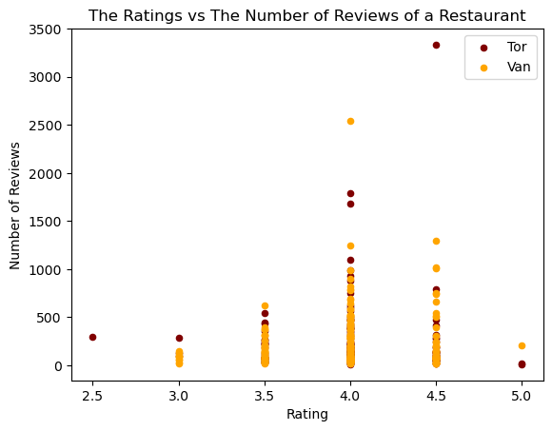
Do Number of Reviews a Restaurant have any effect on the Restaurant’s Rating?
*Pai Northern Thai Kitchen
18 Duncan Street

Slide 14
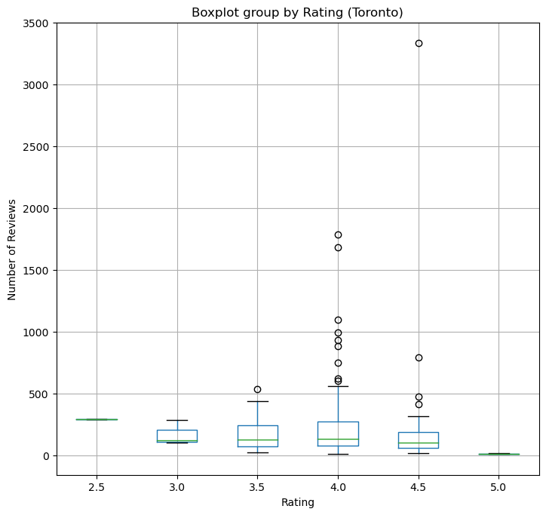
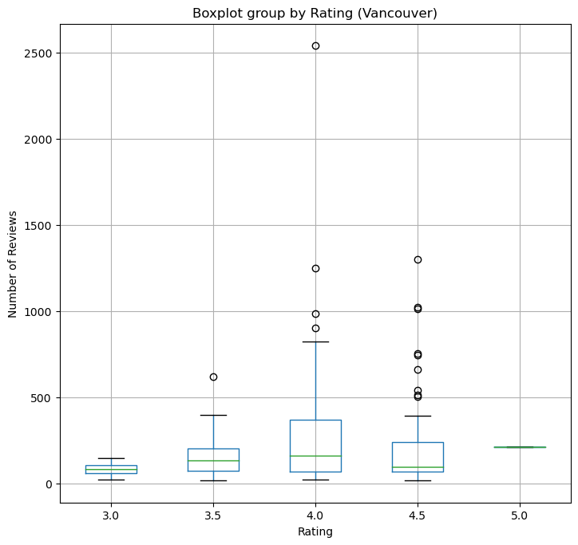
F-Test=0.691 P-value = 0.733

Slide 15
The number of reviews DOES NOT have an effect on the restaurants ratings on Yelp

Slide 16
Analyzing Restaurant Diversity: Toronto vs. Vancouver
Uniqueness of Options
What options exist in each city?
What exists in one but not the other?
Uniqueness in Taste
What categories rate better in either city?
Any differences in the distribution of restaurants across categories?

Slide 17
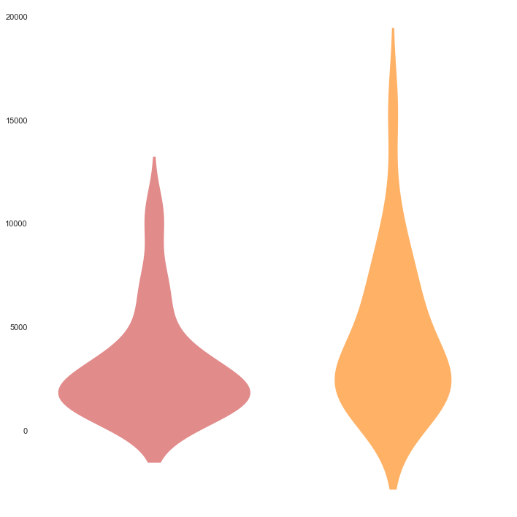
Toronto
Vancouver
Total Categories
122
119
Total Reviews per Category

Slide 18
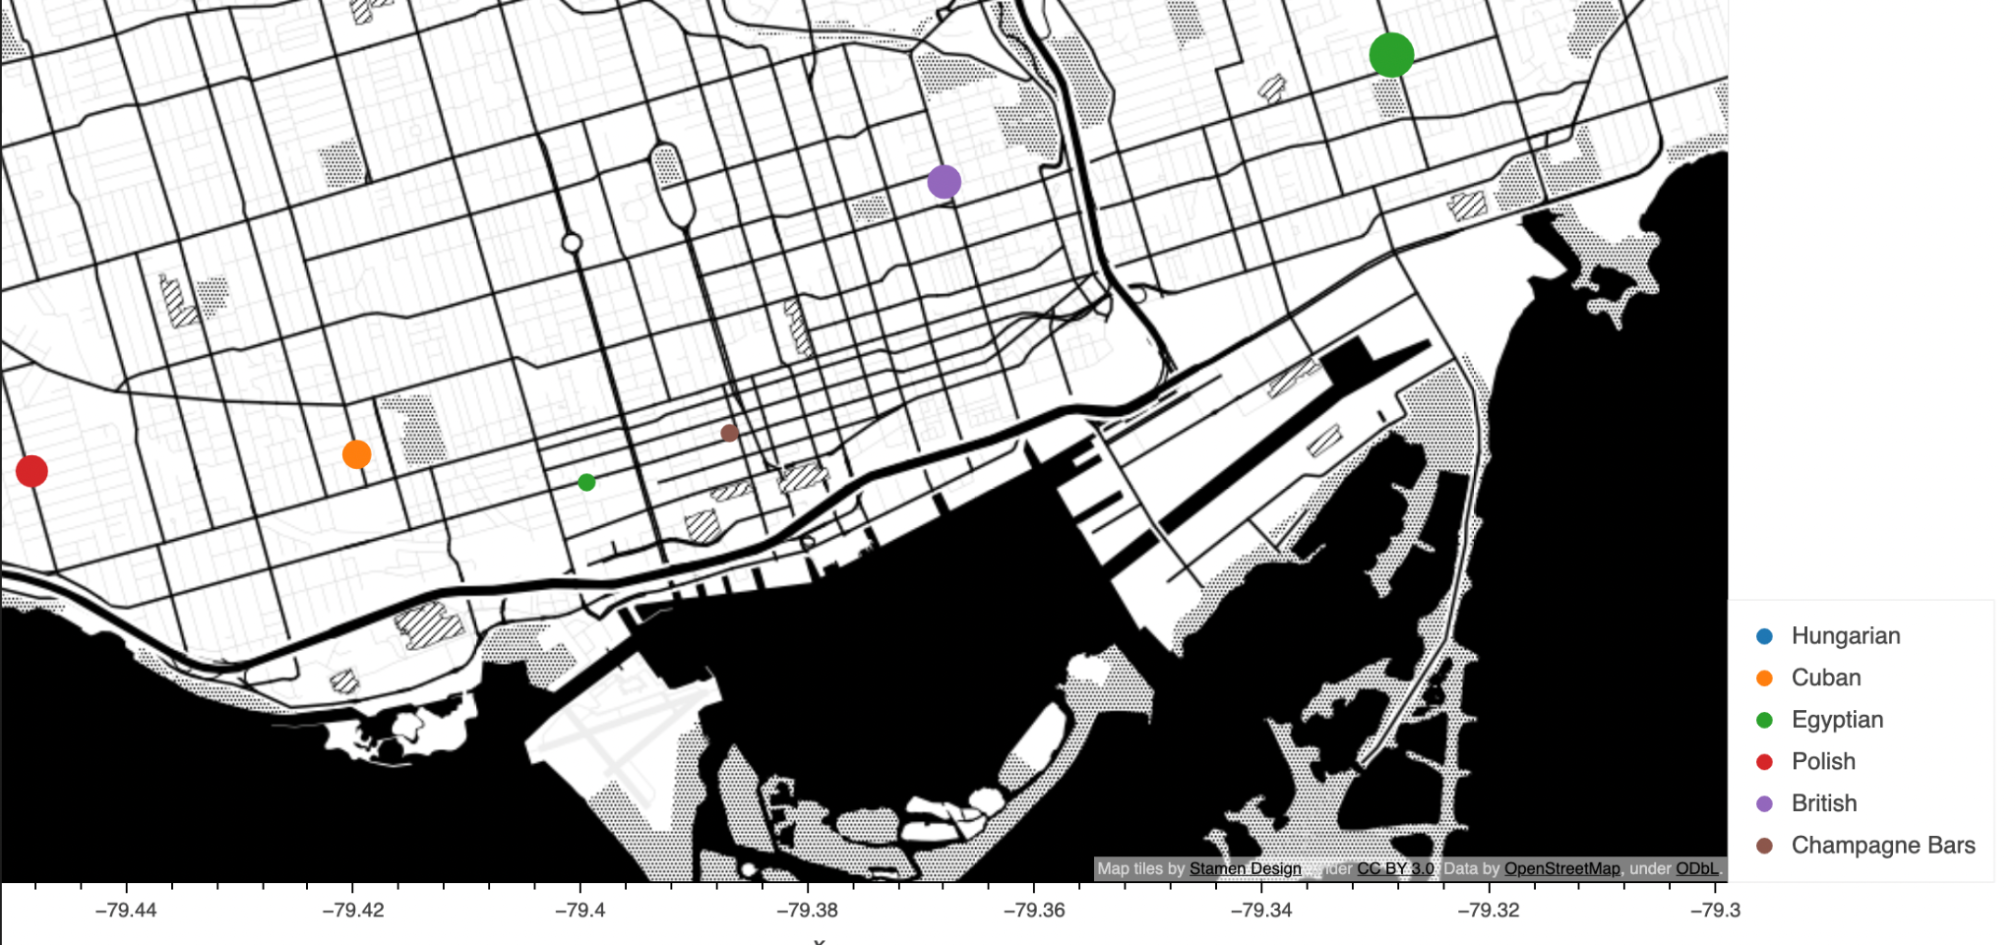
Unique Restaurants in Toronto (29 Unique Categories)
Notable mentions: Maha’s (Egyptian), The House On Parliament (British), Café Polonez (Polish)

Slide 19
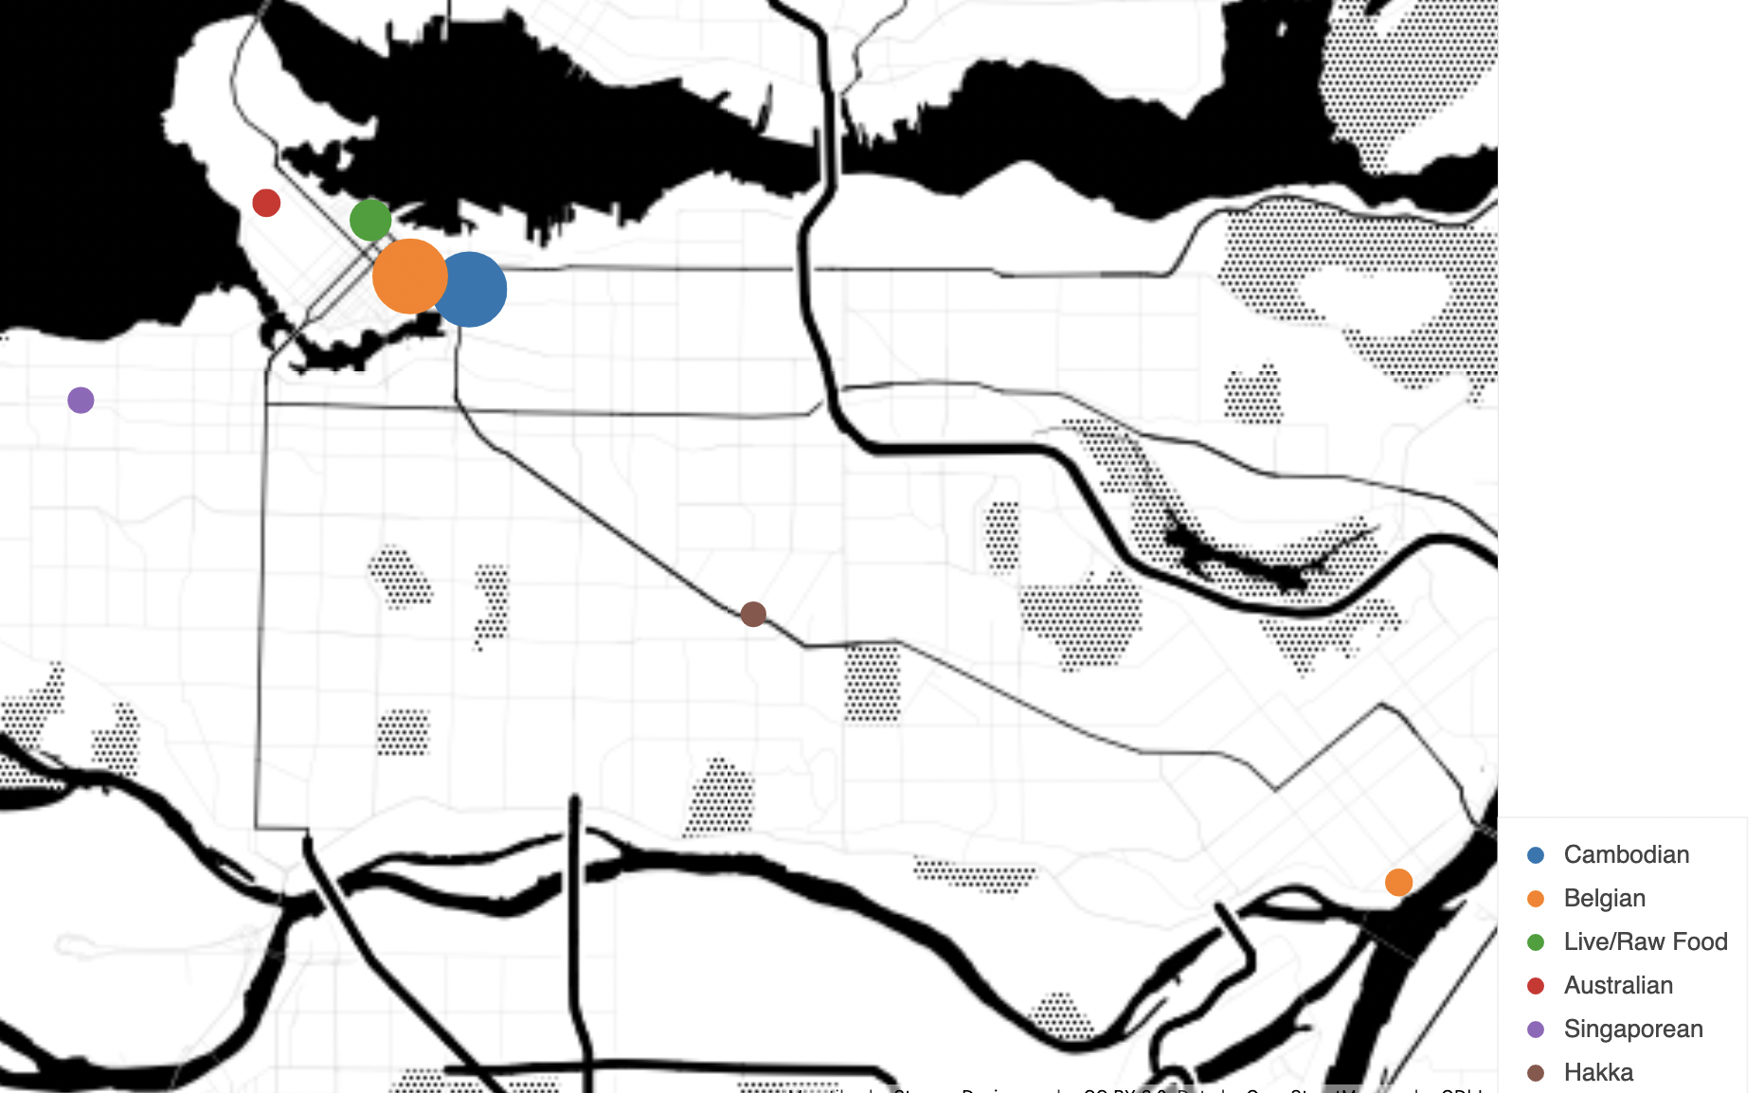
Unique Restaurants in Vancouver (26 Unique Categories)
Notable mentions: Phnom Penh (Cambodian), Chambar (Belgian), Nightingale (Live/Raw Food)

Slide 20
Weighted Rating per Common Category
𝝨
Restaurant Reviews
Restaurant Rating
_______________________
Total Category Reviews

Slide 21
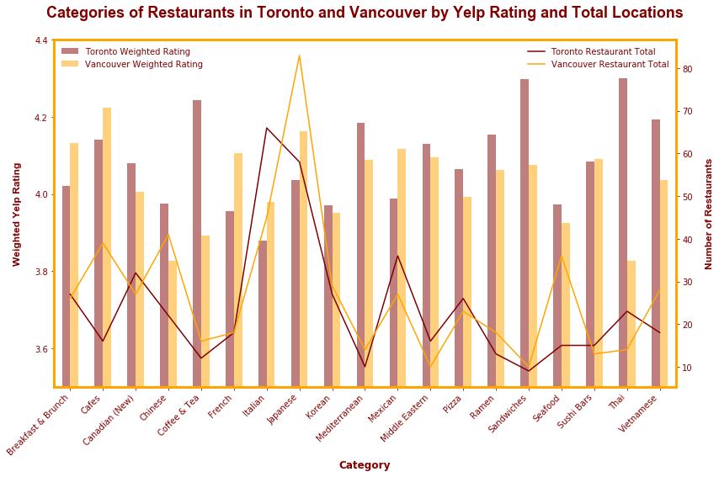

Slide 22
Are the Yelp ratings of the categories of restaurants independently distributed?
Is the distribution of restaurants across categories independent between Toronto and Vancouver?
probability=0.950, critical value=16.919, stat=0.015
The distribution of Yelp Ratings by category is independent between Toronto and Vancouver.
probability=0.950, critical value=16.919, stat=25.697
The distribution of Restaurants by Yelp category is not independent between Toronto and Vancouver.

Slide 23
Thank You
Questions?

